Slide 1

Marketing Strategy
Marketing Analytics

Slide 2
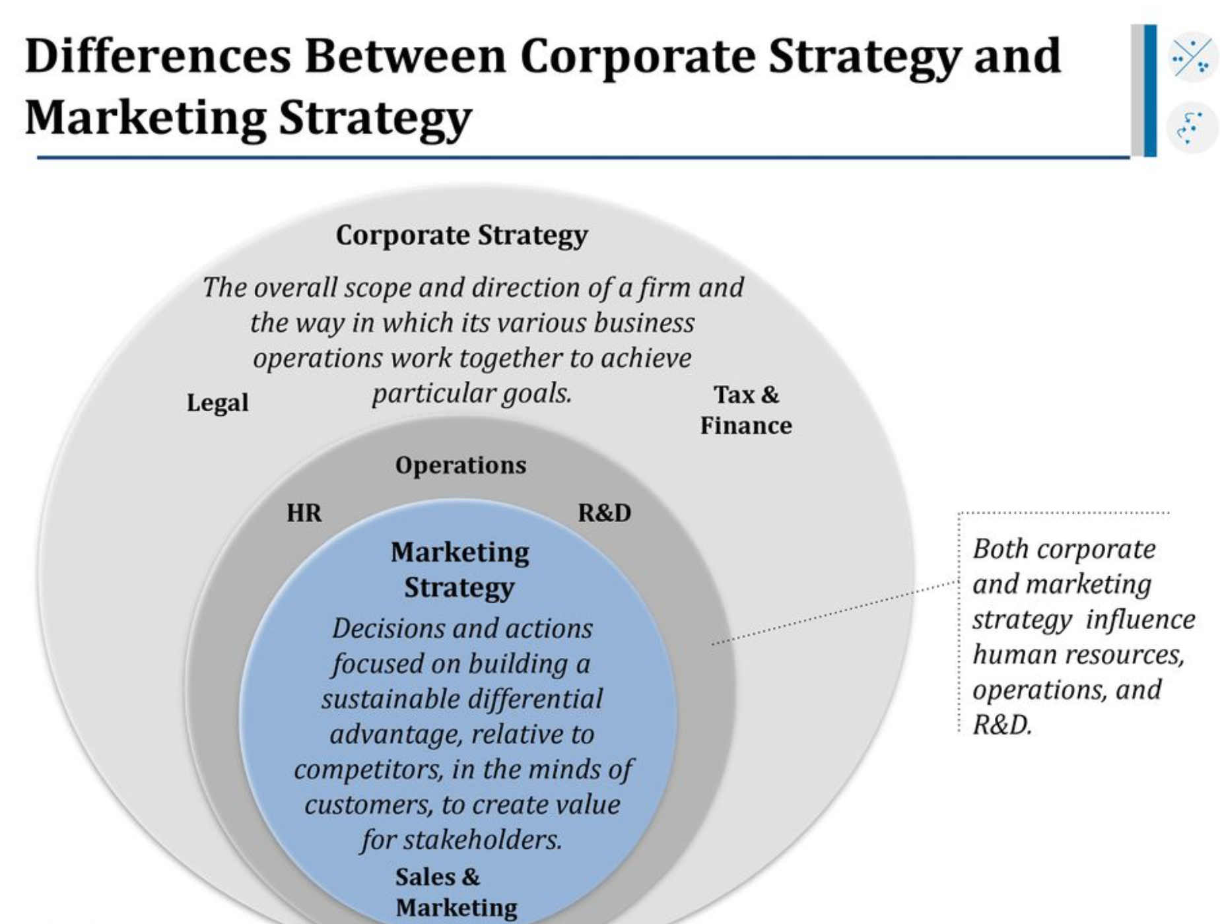

Slide 3
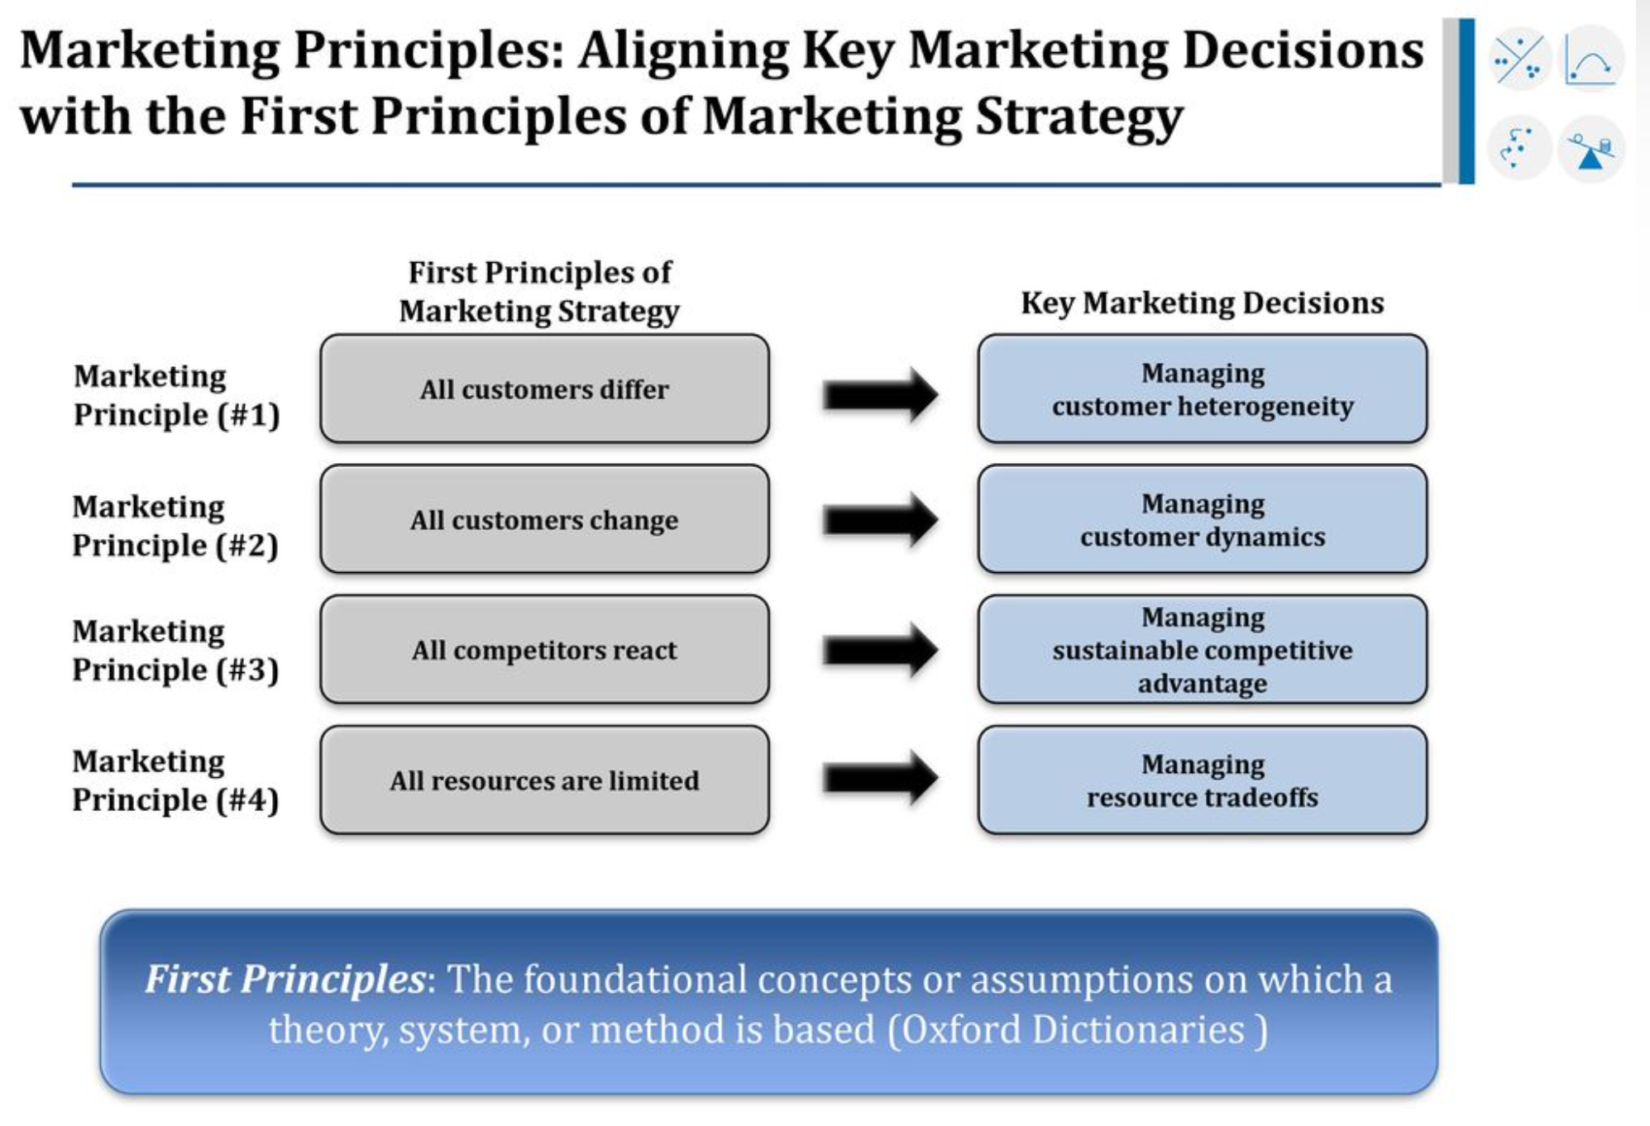

Slide 4
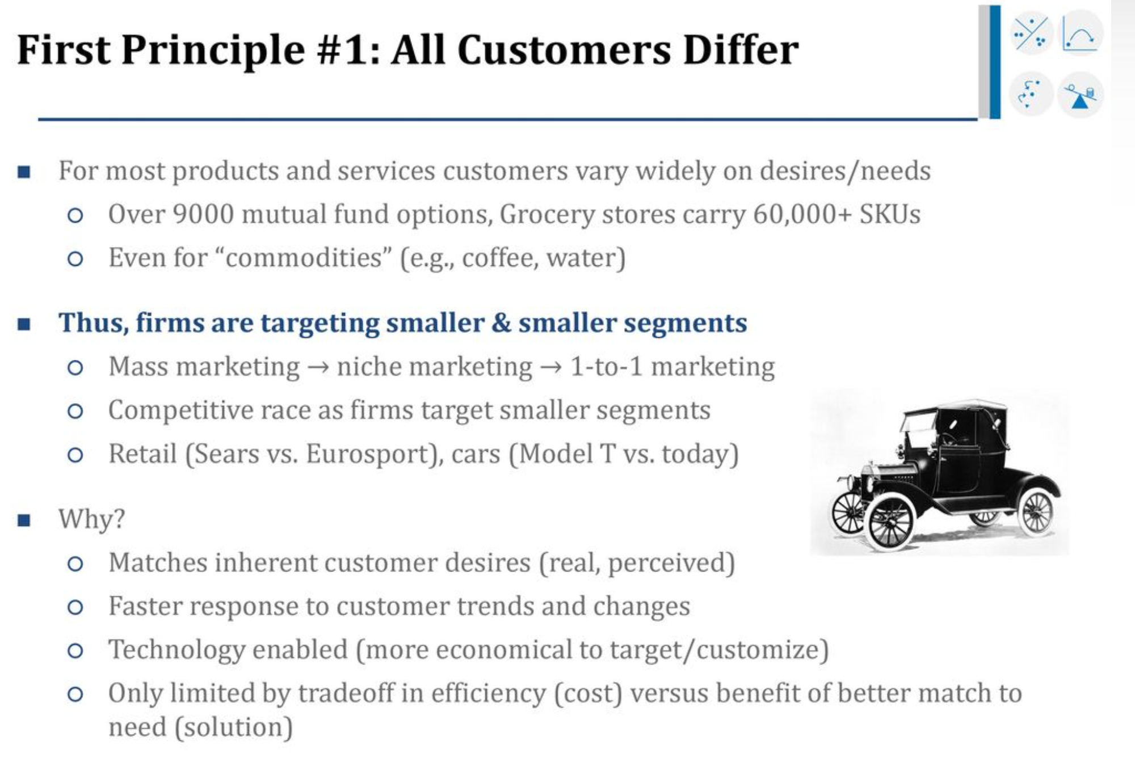

Slide 5
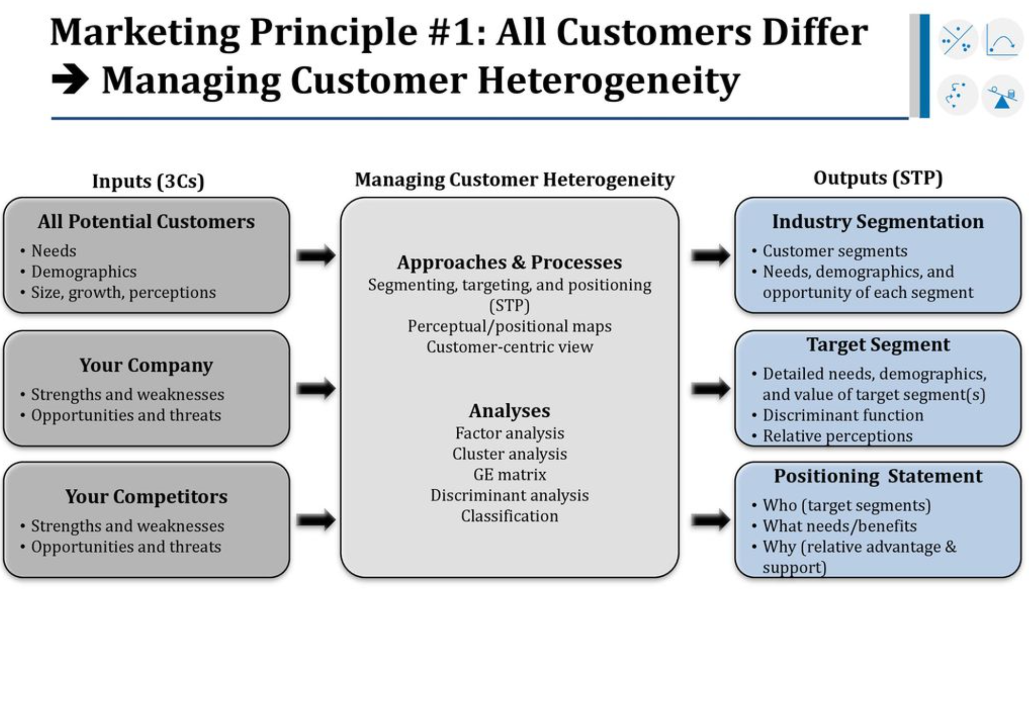

Slide 6
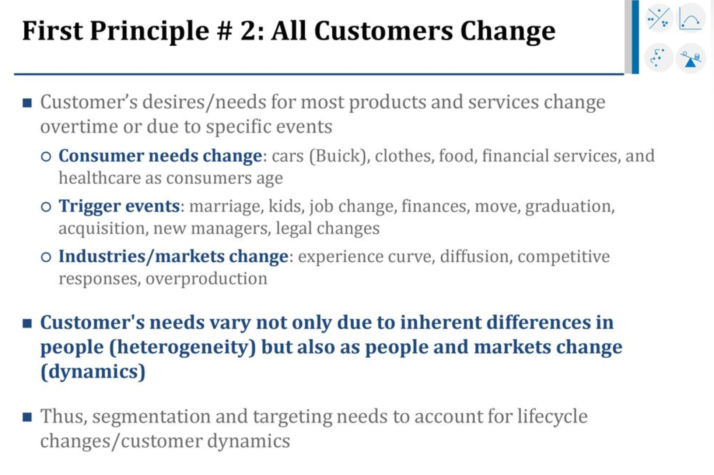

Slide 7
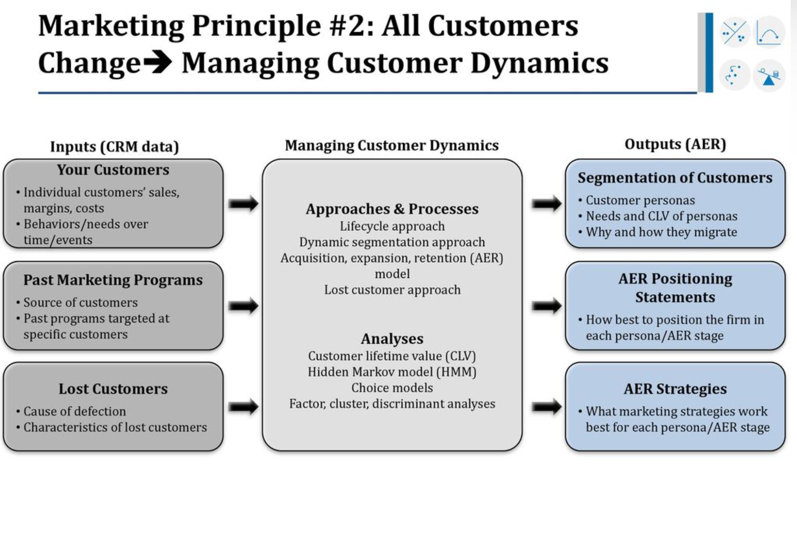

Slide 8
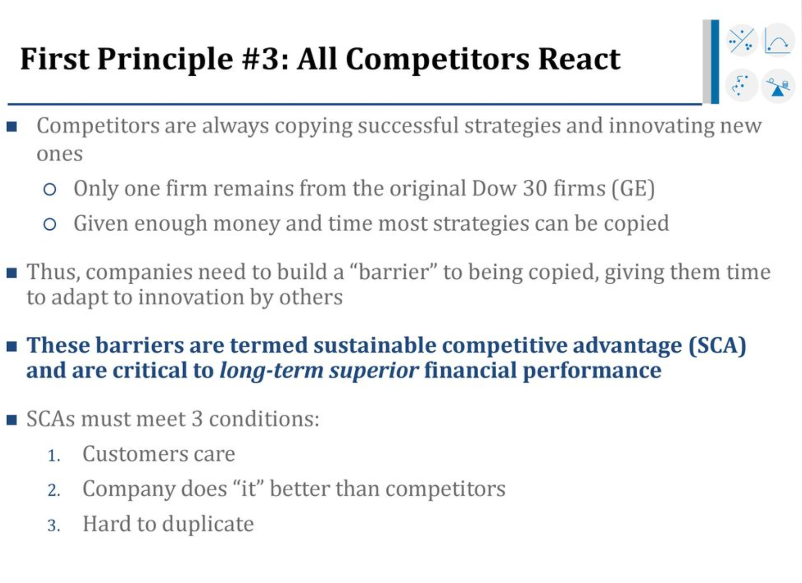

Slide 9
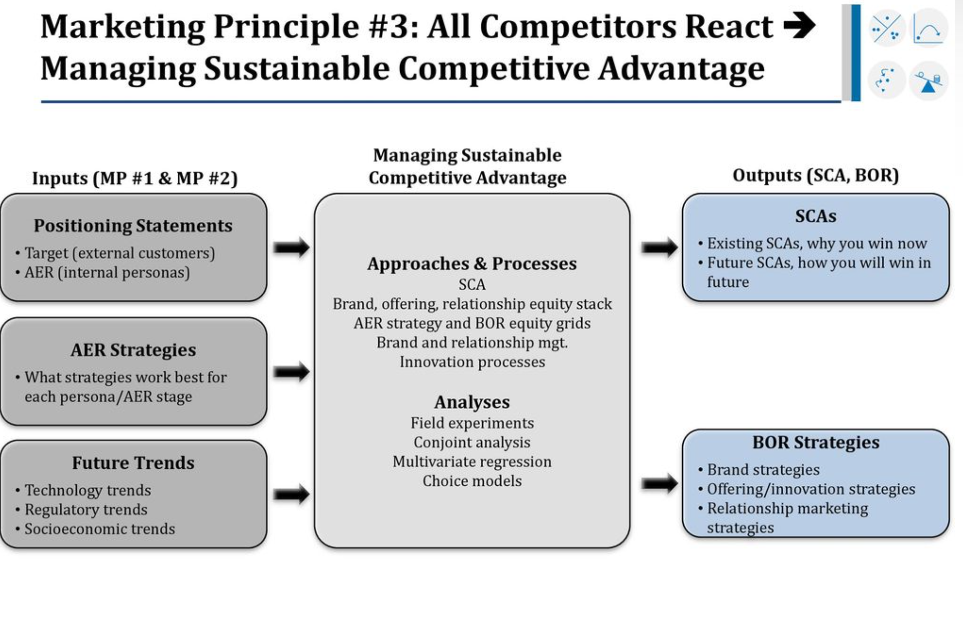

Slide 10
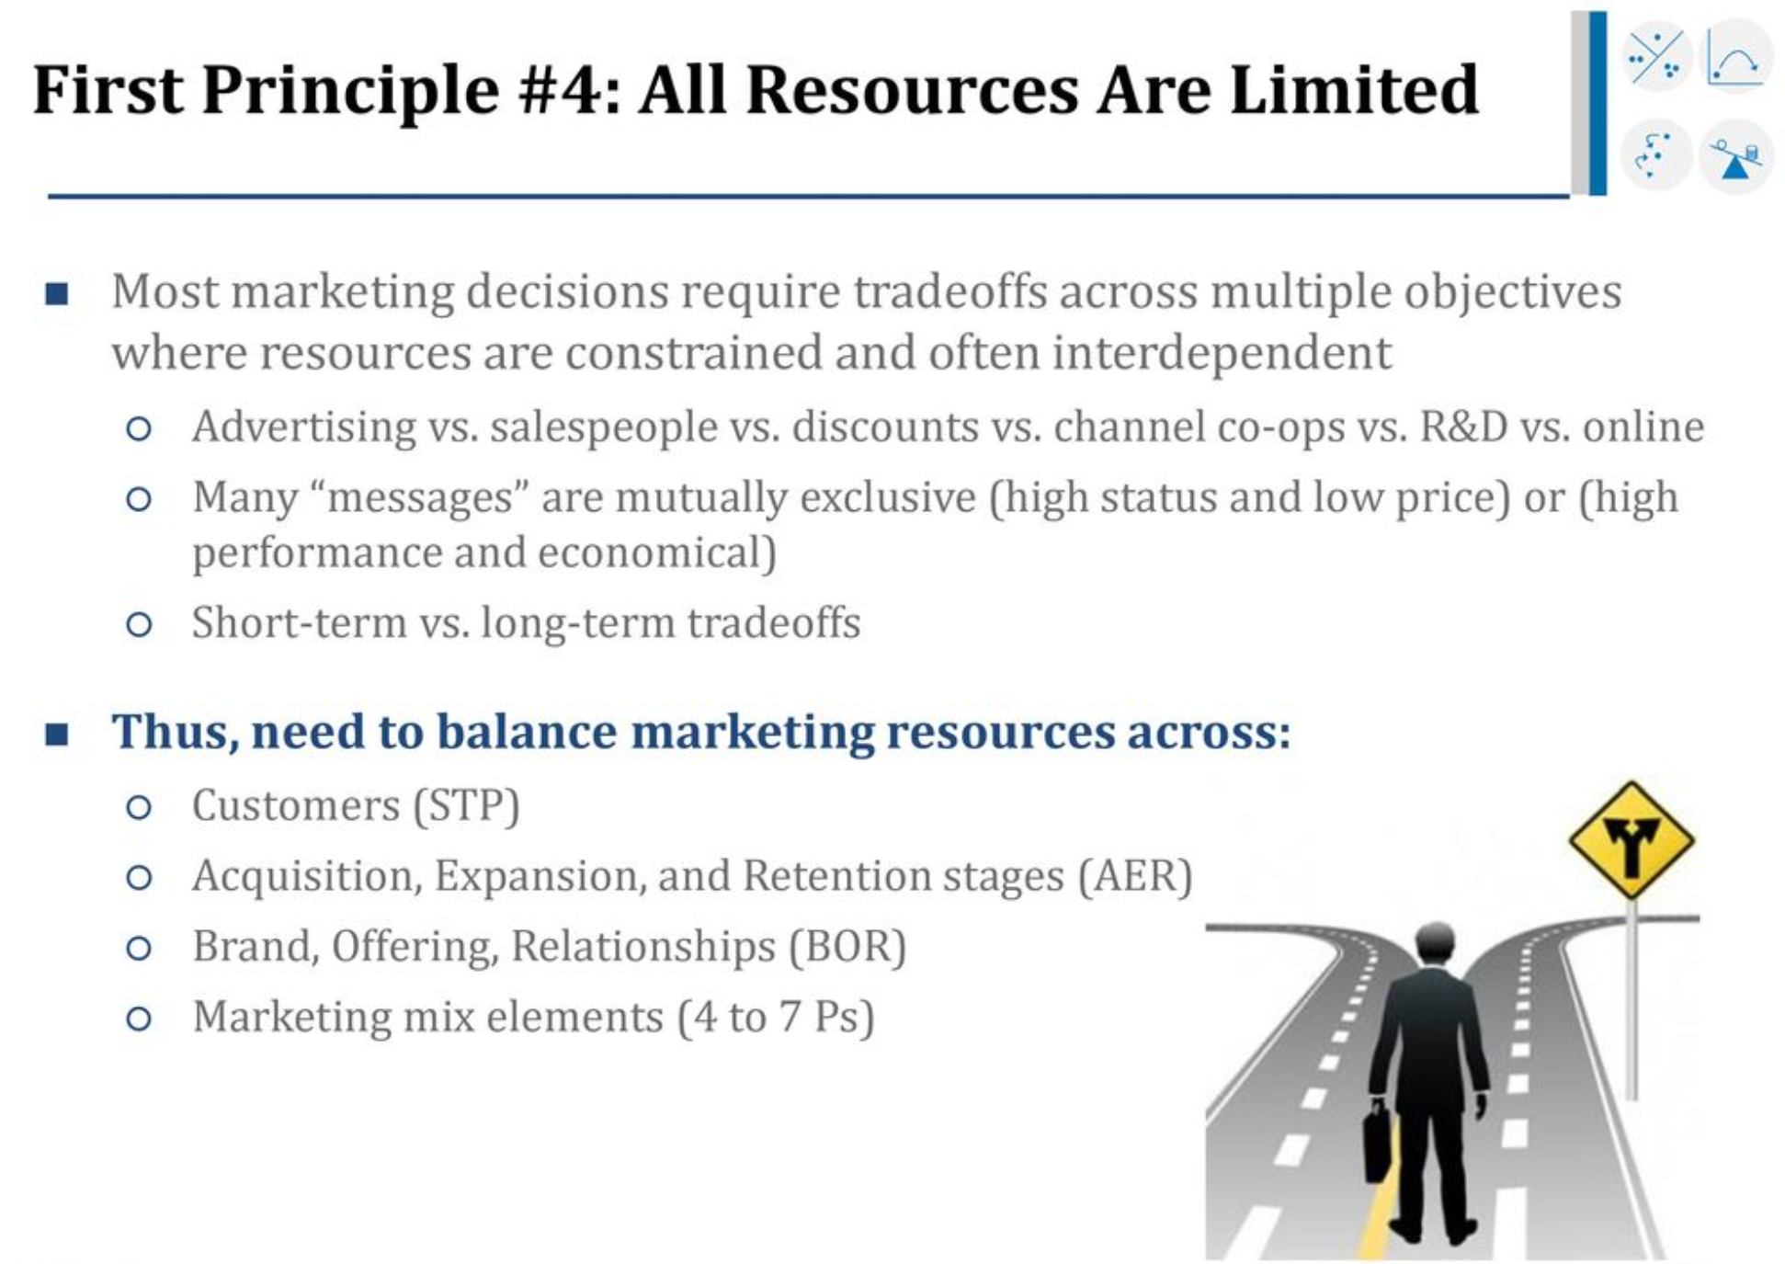

Slide 11
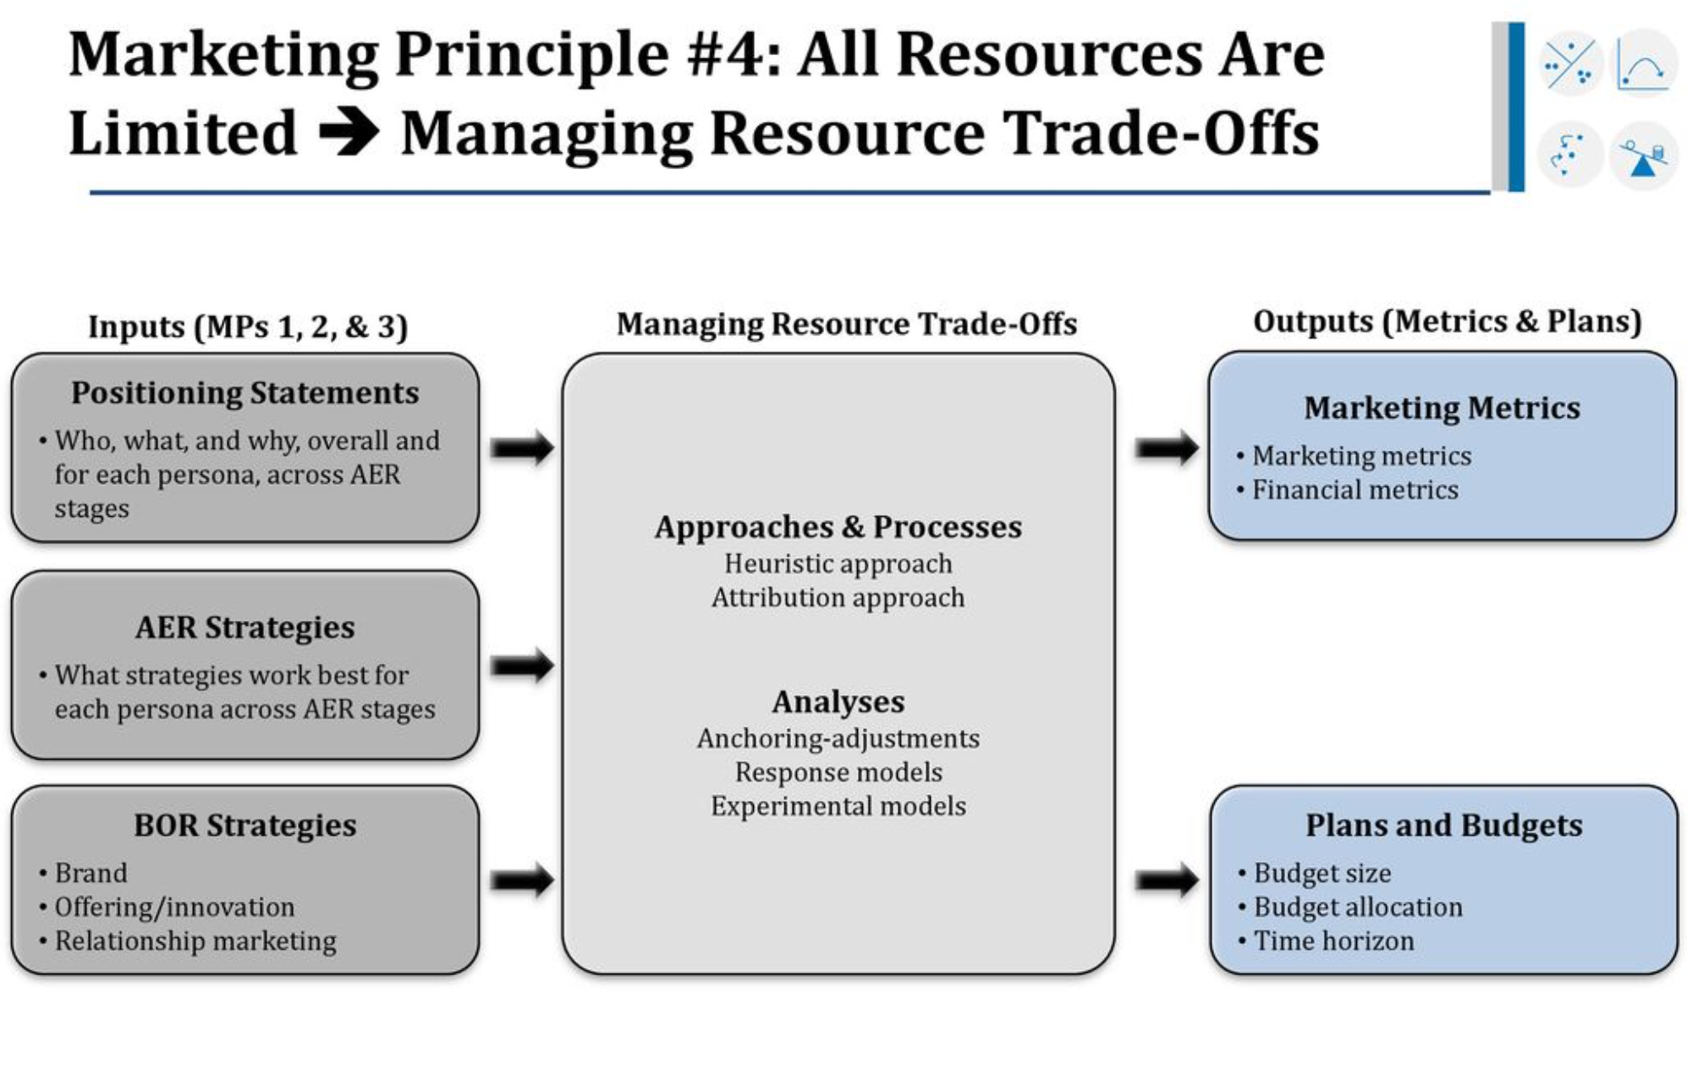

Slide 12
Marketing Analytics “If you cannot measure it, you cannot improve it”--- Lord Kelvin

Slide 13

World Data is doubling in every 2.5 years!

Slide 14

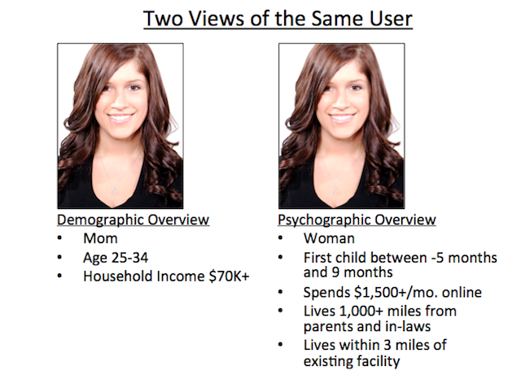
There are more than 7 billion people on the world
More than 5.1 Billion of them own a cell phone

Slide 15
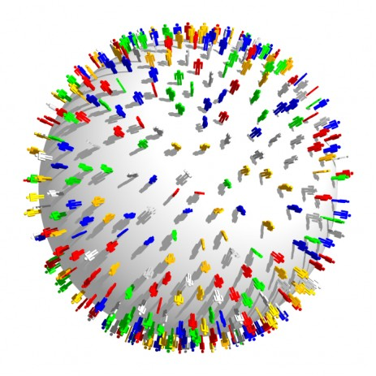
Each Day
We send over 11 billion texts
Watch over 2.8 billion YouTube videos
Perform over 5 billion Google searches
We are Data Agents!
We Generate over 2.5 Quintillion bytes everyday from
Consumer Transactions
Communication devices
Online behavior
Streaming services

Slide 16

By 2020 we will need …
10x more servers
We will fall short of Big data talents by 100k
50x more Data Management
We need new tools and talents to mine this information
75x more files to handle it all
We need Big Data Analytics
https://fybr.com/media/

Slide 17
Marketing is the new Finance!
“ I think marketing is the new finance. In 1960s and 1970s we got interesting financial data, and a lot of analytics fire power focused on data.. I think marketing is in the same place today. So my view quants are going to move from Wall street to Madison Avenue”
Hal Varian (Chief Economist, Google)
“ The highest level of analytics being done in Dominos is in Marketing Department, not in finance department, and I will tell you that is a dramatic change”
Patrick Doyle, CEO, Dominos

Slide 18

What is Marketing Analytics
Use of appropriate techniques and tools that help us take actionable insights (represents Models and Metrics)

Slide 19



Models: Styles
Verbal
Pictorial
Mathematical
Expressed in words
Expressed in charts/graphs
Expressed in equation
Simplified representation of reality
Evaluate impact of input variable
Models provide guidance on marketing actions

Slide 20



Models: Forms
Descriptive
Predictive
Normative
Identify causal relationship and relevant variables
Determine likely outcome given certain inputs
Best course of active to maximize objectives

Slide 21
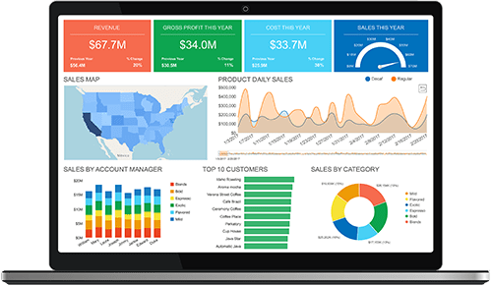
Metrics
Definition: Business oriented key performance indicators
Sales per channel, cost per sale
Purpose: Monitor and improve marketing effectiveness and take corrective action
Marketing Dash boards
Marketing Automation system (Eloqua, Marketo, Pardot)
Sales Automation system (Netsuite, saleforce.com)

Slide 22
Market Description
Topic Description
Market Description Describe market based on need that product fulfills
Avoid overly narrow (product-based) descriptions
Example: Wang word processors in 1980s
Market Groups of customers buying products from sellers
Potential Market All people in population with interest in product/service
Available Market People with interest, plus means (money)
Qualified Available Mkt. Legally allowed to purchase product/service
Served Market Segments targeted by company
Potential Market
Available Market
Qualified Available Market
Served Market
Notes:
.

Slide 23
Industry Description
Topic Description
Industry Groups of sellers making “similar” products/ services
Example: White Goods (appliances) industry
Companies: GE, Westinghouse, Samsung, etc.
Category Subset of industry
Group of competing firms selling to market segment
Example: High-end kitchen appliance manufacturers
Companies: Viking Sub Zero and wolf etc.
Industry
Example: White Goods (Appliances)
Category
Example: High-end Appliances

Slide 24
Market Data Sources
Secondary Research
Primary Research
Government Data
Surveys
Analyst Reports
Commissioned Reports
Business and Trade Publications
B2C: Retail Salespeople
Other Sources
B2B: Company Salespeople

Slide 25
Government Data
Government Data
U.S. Census Bureau: Census every 10 years, plus New American Community estimates
U.S. Bureau of Labor and Statistics: Data on employment, productivity, inflation, etc.
U.S. Bureau of Economic Analysis: Data on national GDP, regional GDP, personal income,..
Local Chambers of Commerce: Data on local area

Slide 26
Market Sizing: Stakeholders
Marketing Departments
Channel Partners
- Investigate new markets
- Calculate market share
Stakeholders
for
Market Sizing
- Number of units to move in channel
Operations Departments
Financial Services
- Products manufacturing: how many units to make
- Service delivery: how many people to hire
VC: Large and growing market
- $500M - $1B

Slide 27
Market Sizing: Applications
Market Segments
Market Trends
- Number & size of segments
- Take advantage of trends
Market Share
Sales Forecasts
- Need total size to calculate share
- Forecast as % of total market
Adoption Rate
Market Sizing
Applications
Salesforce Sizing
- Keeping up with industry average?
- Number of salespersons to hire
Life Cycle
Distribution Channels
- Growth or decline?
- Type of channel(s) to employ
Market Investment
Continue investing in market?
Explore new niche?

Slide 28
Market Sizing Approach: Top Down
General Market
* Factor 1 =
Intermediate Market 1
* Factor 2 =
Intermediate Market 2
* Factor 3 =
Objective Market

Slide 29
Market Sizing (Top-down approach)
Step | Data
Determine relevant population | Population of United States (323.1 million)
Determine factor 1 | % of residents who floss daily (12%)
Determine factor 2 | Number of uses per year ( 365)
Determine factor 3 | Amount of product consumed per use (1 ft)
Determine factor 4 | Price of 1 foot ($0.03)
Determine factor 5 | % of consumers choosing eco-friendly floss
Calculate Demand | $ 8.40 million dollar per year
Example: Market for eco-friendly dental floss

Slide 30
Top Down: Area Market Demand
Geographic Area of Interest
Example: State of Ohio
General Geographic Area
Example: USA

Slide 31
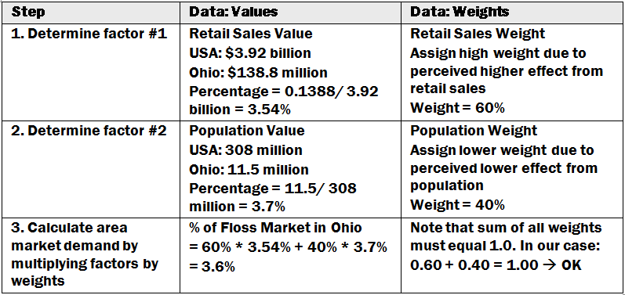
Top Down: Area Market Demand
Multiple-Factor Index Example: Eco-friendly floss for Ohio

Slide 32
Bottom Up
Add up sales from each potential market segment
Example: Total demand for TBM (tunnel boring machines)
Market
Sub-Segment 1
Sub-Segment 2
Sub-Segment 3
Municipalities
International sales
Major Construction Companies
Bechtel, etc.

Slide 33
Market Sizing (Bottom-up approach
Sub-segment 1
Municipalities
Sub-segment 2
Major construction companies
Sub-segment 3
International Sales
Example: Total Market for a Tunnel Boring Company
Steps involved in Bottom-up approach
Step 1: Identify relevant organizations
Step 2: Determine quantity of those organization
Step 3: Multiply quantity by price to get market size

Slide 34
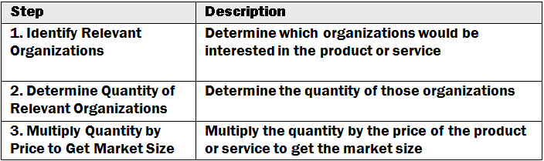
Bottom Up: Niche Market Process

Slide 35
Bottom Up: Niche Markets
Topic Description
Market for PET/CT Scanning Machines Niche Market
Limited demand; Expensive $3M each
Identify Relevant Organizations Large hospitals: over 500 beds
Determine Quantity of Organizations 5% of hospitals over 500 beds
5,795 hospitals in USA
= 290 hospitals
Multiply Quantity by Price Price = $3 million each
290 hospitals * 3 million = $870M
Identify Other Markets Looks for other markets: Urgent Care
Repeat process for those markets

Slide 36
Bottom Up: Market Buildup Example
Topic Description
Buildup Example You are the marketing manager for a small ad agency
Specialty: Professional services in state of Arizona
You want to estimate your potential market size
1. Identify Buyers You often do business with the following industries:
Accounting, Engineering, and Legal services
2. Identify Buy Rate Research industry average for ads as % of revenue:
Industry NAICS Revenue %
Accounting 541211 $400M 2%
Engineering 541330 $1,100M 1%
Legal 541110 $1,400M 3%
3. Sum ($400M)(2%)+($1100M)(1%)+($1400M)(3%) = $61M

Slide 37
Bottom Up: Limited Distribution
Aggregate Market
Channel 1
Channel 2
Channel 3
Channel 4
Channel 5
Channel 6
Individual Customers
Example: Only 39 Ferrari dealerships in entire United States of America

